Slide 1
ImageJ and Friends
Retrospective, current status and future
(State of the Union)
Notes:
[Curtis] Hi! I’m Curtis Rueden. Also speaking with me today are Tobias Pietzsch and Christian Dietz. We are here to talk to you about “ImageJ and Friends”: a collaboration of software projects that we have been pursuing for almost ten years.
Please notice that there are no organizational logos on this title slide. We are three people who are driving various aspects of this effort—but by no means do we represent everything important that is going on in the ImageJ ecosystem.

Slide 2
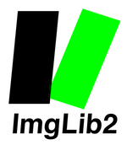
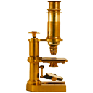
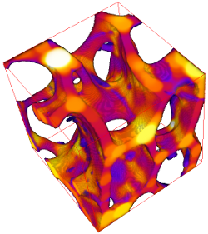
Notes:
[Curtis] Today, there are many tools in the current “State of the ImageJ and Friends Union.” For historical reasons spanning the past two decades, the ecosystem is complex, with an alphabet soup of logos. We would like to take you on a brisk stroll through those years, to give you some context for what these various projects are, what each seeks to accomplish, how the projects fit together, and where they are headed.
But first, a quick challenge for you: can you find the NEW IMAGEJ LOGO, cunningly hidden on this slide? The color scheme is not yet finalized.

Slide 3
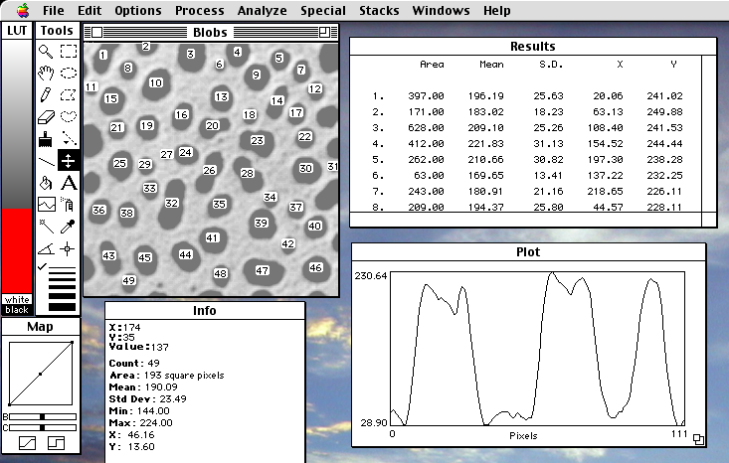
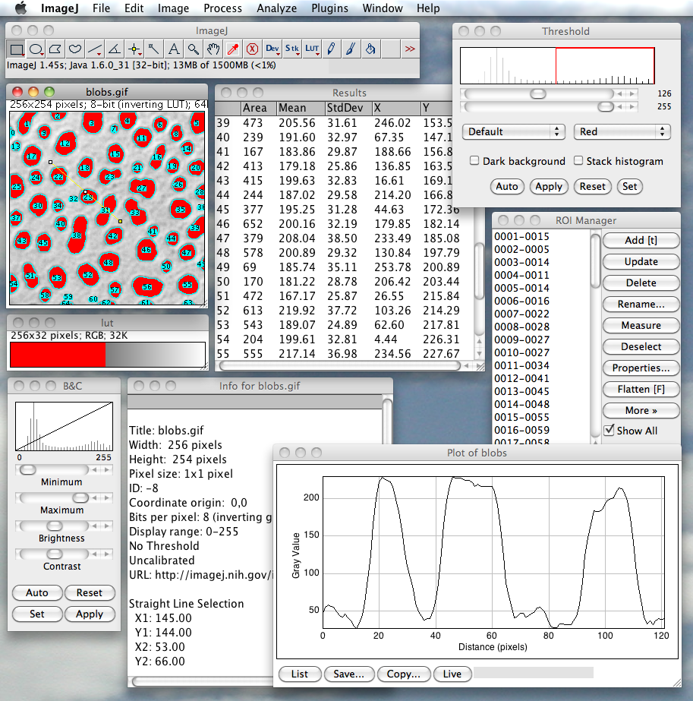
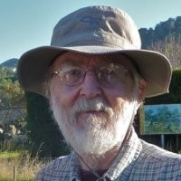
NIH Image
ImageJ
https://imagej.nih.gov/ij
Schneider C. et al. (2012) Nature Methods
Notes:
[Curtis] OK. Our stroll begins in 1997, when Wayne Rasband decided to port his NIH Image program to Java, and ImageJ was born.
The goal was not to invent a radical new user interface, but rather to make the program more accessible and cross-platform, via Java’s design goal of “write once, run anywhere.”
If you’re curious, check out the 2012 Nature methods paper cited here, which offers many more details on how ImageJ got started.

Slide 4
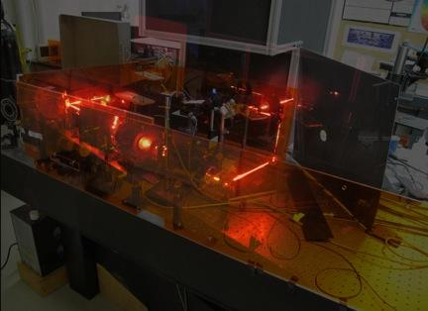
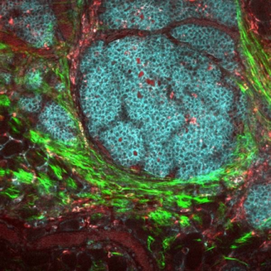
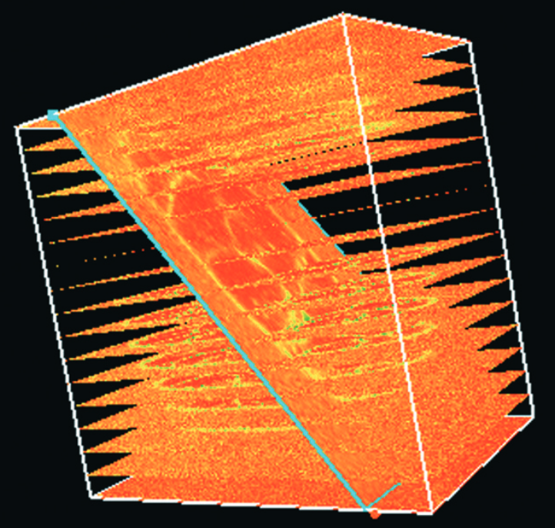
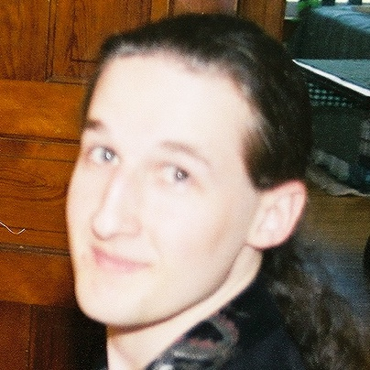
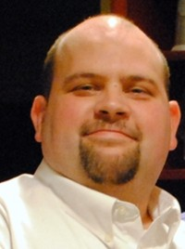
Scopes
Science
Software
The Eliceiri lab develops advanced optical and computational techniques for imaging and experimentally manipulating living specimens.
https://loci.wisc.edu
Notes:
[Curtis] My involvement with this community began a few years later in late 2001, when I joined the Eliceiri group at the University of Wisconsin-Madison —also known as the Laboratory for Optical and Computational Instrumentation, or LOCI. We are a biophotonics lab in the Cell & Molecular Biology department. We build light microscopes; we use them for scientific imaging; and we write software for working with those images.

Slide 5
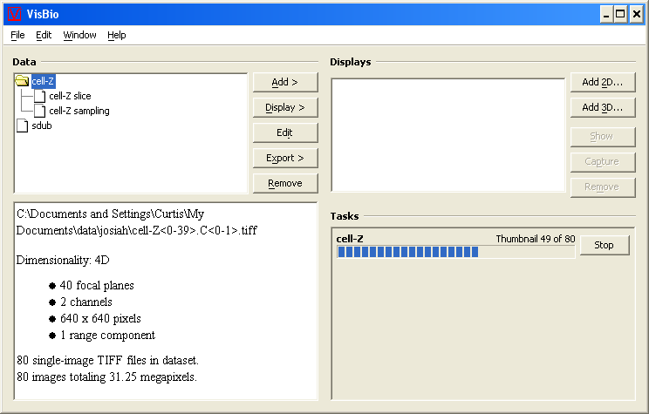
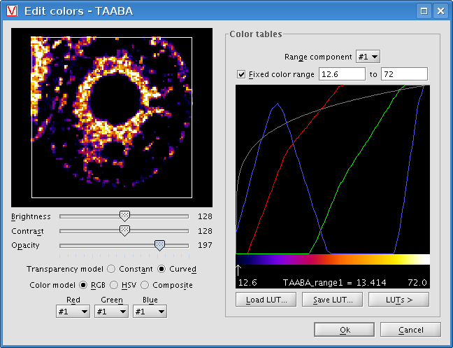
https://loci.wisc.edu/software/visbio
Rueden C. et al. (2004) Traffic, Rueden C. et al. (2006) Microscopy Today
Notes:
[Curtis] The tool I was brought on to develop was a multidimensional biological visualization tool called VisBio. It was built on a powerful Java library called VisAD that I had helped to develop. By 2005, VisBio had an N-dimensional data engine; fully customizable color lookup tables...

Slide 6
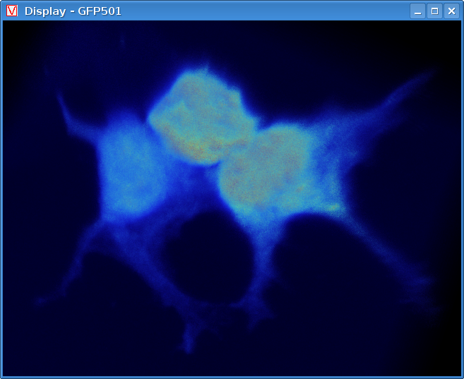
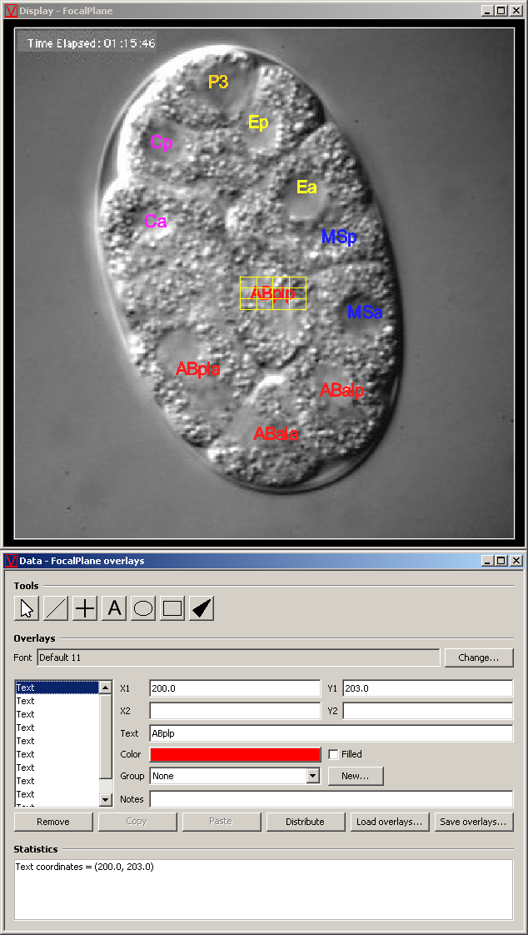
https://loci.wisc.edu/software/visbio
Rueden C. et al. (2004) Traffic, Rueden C. et al. (2006) Microscopy Today
Notes:
[Curtis] ...3D volume rendering; perspective and parallel projection of multi-slice data; arbitrary slicing of that data; and support for several kinds of annotation overlays including lines, points, text, ovals, rectangles and arrows.
Maybe this sounds familiar to some people? :-)
We eventually added some integration with ImageJ, too, so you could pass images back and forth between ImageJ and VisBIo.
But we were still reinventing the wheel...

Slide 7
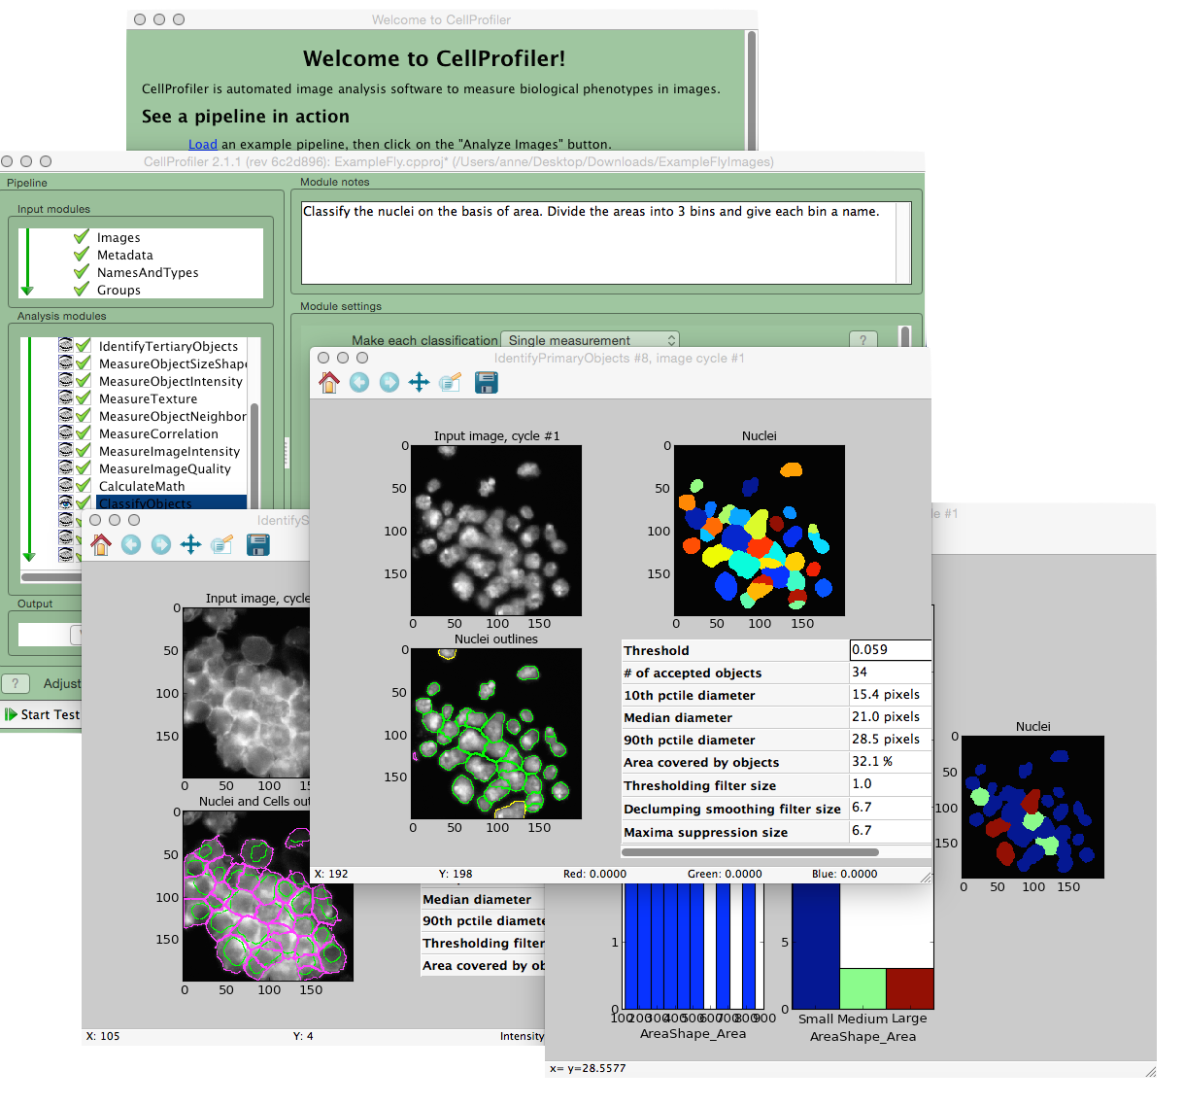
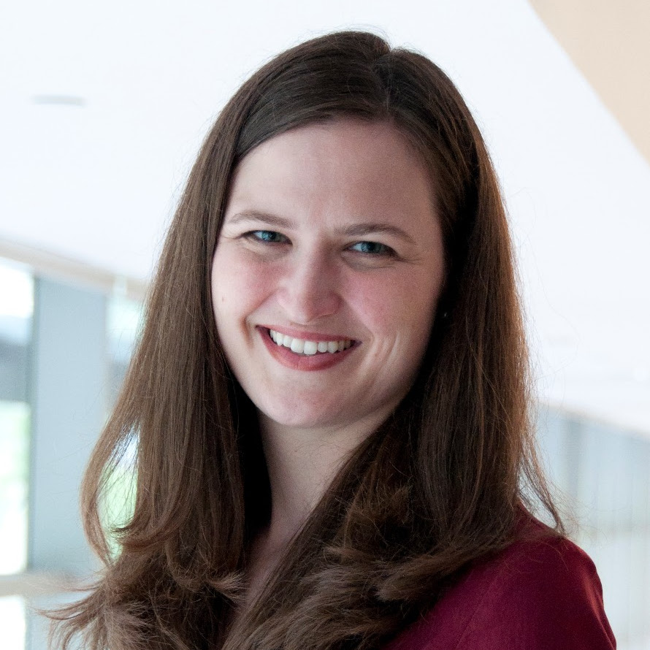
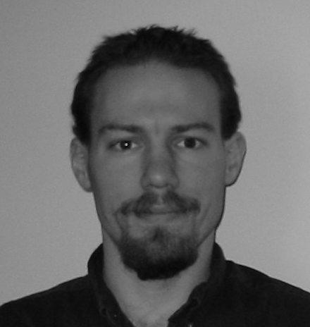
https://cellprofiler.org
Notes:
[Curtis] Meanwhile, in Anne Carpenter’s group at the Broad Institute, Ray Jones was developing the first version of CellProfiler in MATLAB. Years later, for CellProfiler 2.0, the project switched to Python.

Slide 8
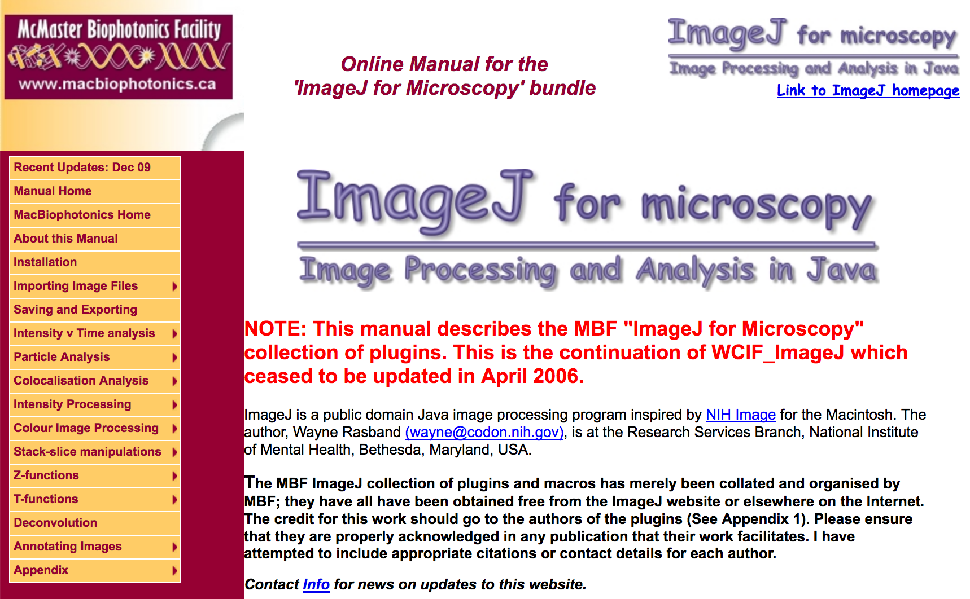
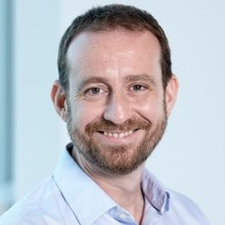
https://imagej.net/MBF_Plugin_Collection
Notes:
[Curtis] By 2005, ImageJ’s flexible plugin architecture had resulted in a lot of plugins written by the community. It was starting to be more complicated just keeping track of all the plugins you might want to have installed, as well as how to use them to accomplish various tasks. A researcher named Tony Collins created an “ImageJ for microscopy” manual as a web site. The site offered a download of ImageJ plus useful plugins described in the manual, first distributed under the name of WCIF ImageJ, and later rebranded as MBF ImageJ.
This plugin collection helped to serve as the inspiration for more ambitious efforts soon to come.

Slide 9
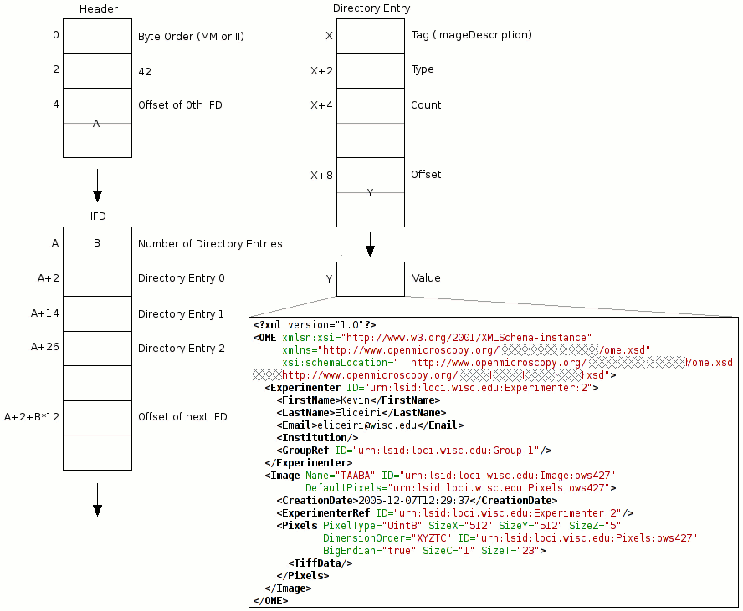
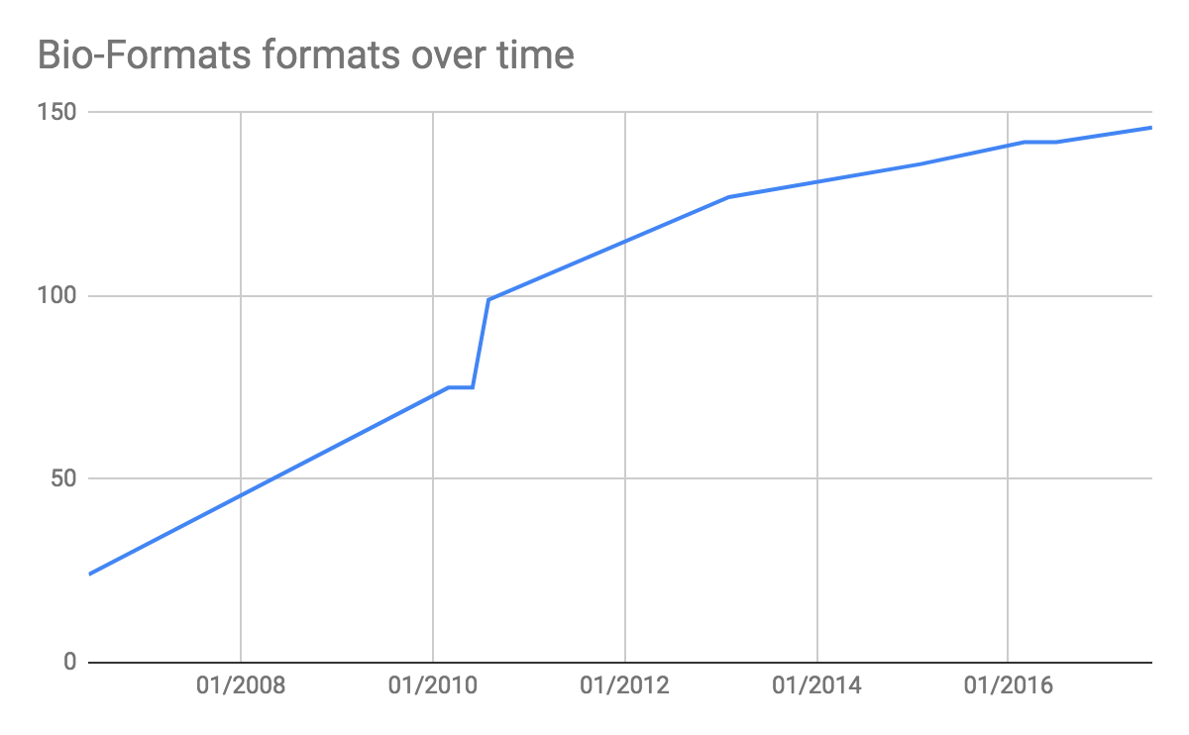
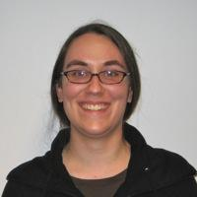
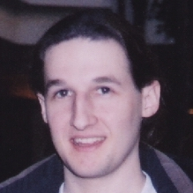
https://imagej.net/Bio-Formats
Linkert M. et al. (2010) The Journal of Cell Biology, Goldberg I. et al. (2005) Genome Biology
Notes:
[Curtis] Back at LOCI, we were busy implementing file format readers for microscopy image data, so that VisBio could open it. We were emailing microscope vendors asking for specifications and sample data. It was a lot of work, and we did not want everyone writing a software package in this field to go through this same effort again and again. So we decided to create Bio-Formats, a shared Java library for reading and writing image file formats in the life sciences. In 2006 we announced the first version of the Bio-Formats plugins for ImageJ.

Slide 10
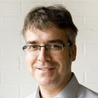
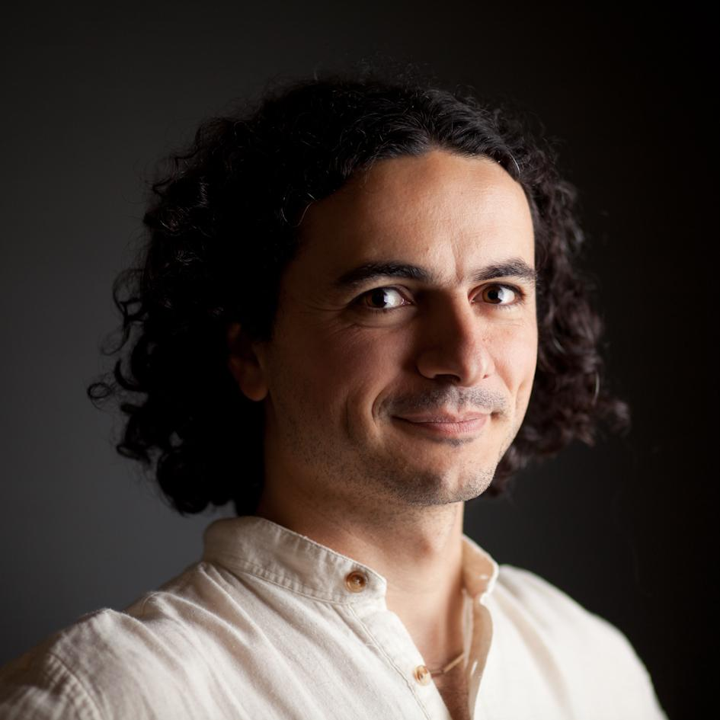
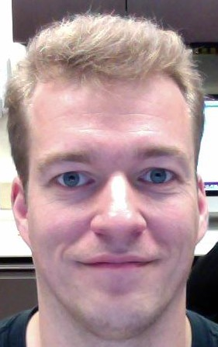
First User & Developer conference for ImageJ, organized by Andreas Jahnen
Rumor has it that this is the first time that Cardona and Schindelin met 💖
https://imagej.net/Conference_2006
Notes:
[Curtis] In 2006, Andreas Jahnen at the CRP Henri Tudor in Luxembourg organized a User and Developer Conference for ImageJ.
Around that time, CRP Henri Tudor launched the first ImageJ documentation wiki, intended to be a central repository for community-driven information about ImageJ and its plugins.
I did not attend this conference, but I have been told that it is the first time that Albert Cardona and Johannes Schindelin met. (Albert: Please correct me if I’m wrong.)

Slide 11
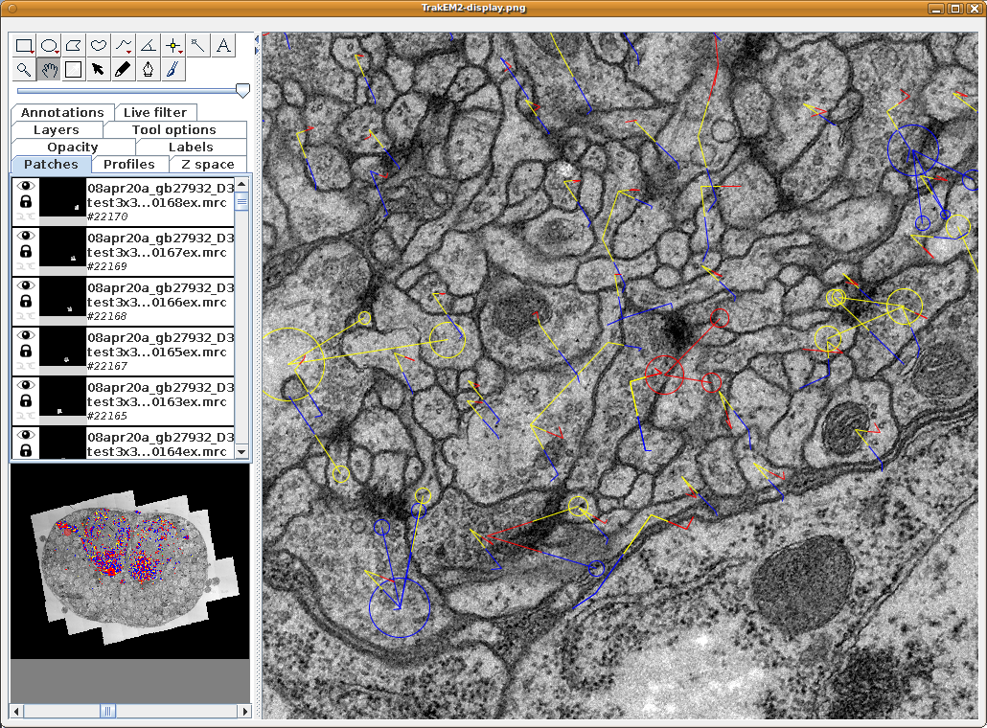
https://imagej.net/TrakEM2
Notes:
[Curtis] At this time, Albert Cardona was developing TrakEM2, an ImageJ plugin for morphological data mining, three-dimensional modeling and image stitching, registration, editing and annotation of large electron microscopy data.
It was very powerful, but more complex to install than most ImageJ plugins.

Slide 12
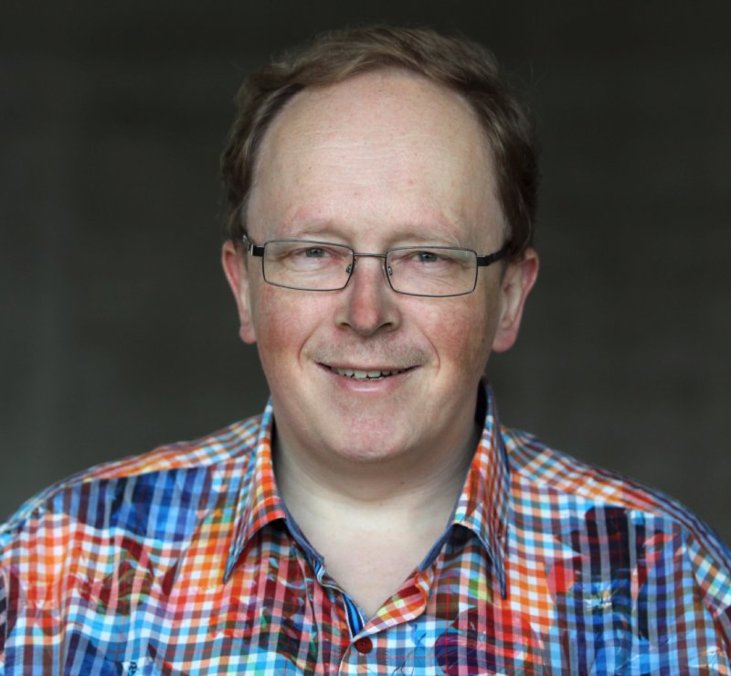
Albert Cardona needs distribution of ImageJ that includes TrakEM
Meets Johannes Schindelin at 1st ImageJ conference
Visits Pavel Tomancak lab at MPI-CBG in Dresden
Johannes and Albert become Founding Mother and Father of Fiji
PAvel gets the title of Funding Father of Fiji
https://fiji.sc
Notes:
[Tobias] Albert and Johannes met at the 1st ImageJ conference,
and Fiji was born, basically as a distribution vehicle for TrakEM.
Around this time, Albert visited MPI-CBG in Dresden. That’s how Pavel Tomancak got involved.
Some years later, I also joined Pavel’s group, and that’s how I got involved.
While Johannes and Albert became Founding Mother and Father of Fiji,
PAvel got the title of Funding Father of Fiji:
There was no dedicated funding for Fiji until much later, but PAvel always managed to fund it on the side.

Slide 13
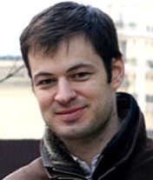
Skeletal biology plugins for ImageJ
Began life as a macro (MomentMacroJ) tracing back to NIH image
Michael Doube meets Albert at 1st ImageJ conference → turn it into a plugin
“... an unexpected, unplanned and unbudgeted side-effect …”
https://imagej.net/BoneJ
Notes:
[Tobias] (2008/01)
Michael Doube, veterinary clinician turned computer programmer wanted tools for doing bone analysis.
So he started the BoneJ project almost at the same time as Fiji.

Slide 14
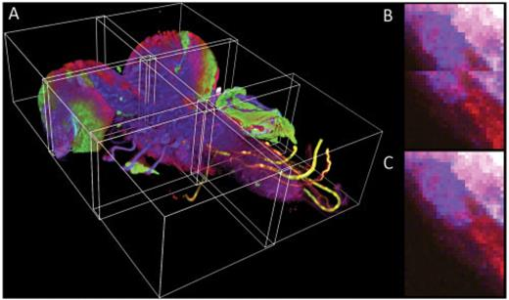
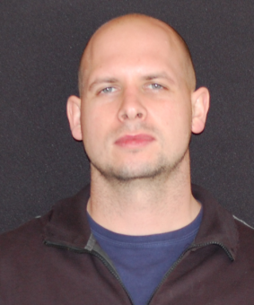
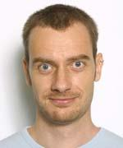
Plugin for stitching of tiled microscopy acquisitions
Based on phase correlation
Simple and intuitive GUI, simply works
One of the most cited Fiji plugins (838 citations)
Later developed by Stephan Preibisch et al. into BigStitcher
https://imagej.net/Image_Stitching
Preibisch S. et al. (2009) Bioinformatics
Notes:
[Tobias]
Meanwhile @MPI-CBG
Already earlier… 2007/08 … Stitching plugin
Did not use ImgLib yet -- helped fuel the motivation for ImgLib

Slide 15
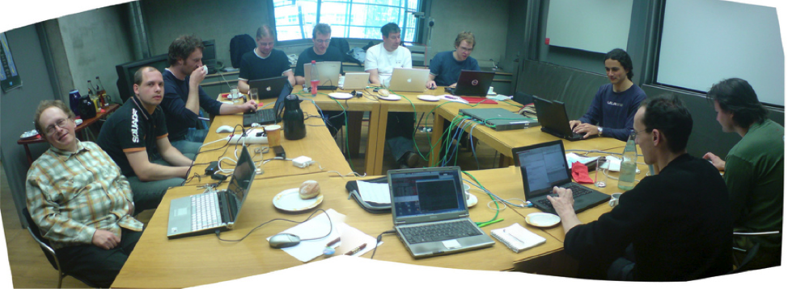
https://imagej.net/ImgLib1
Notes:
[Tobias] (2008/04)
Something new that happened with Fiji were Hackathons,
where the developer community met to discuss and hack, hack, hack
The first of many hackathons to come took place at MPI-CBG
At this first hackathon, a library called imglib started to take shape in the competent hands of Stephan Saalfeld and Stephan Preibisch.

Slide 16
Zeiss SPIM prototype at MPI-CBG
Stephan & Stephan wanted to keep developing in ImageJ (Java) ...
… but ImageJ data structures were lacking flexibility.
ImgLib introduced: Extensible pixel types with shared API Extensible image storage types Uniform nD pixel access on >2G grids
Proxies, layers, interfaces, generics → but modern JVMs are amazing at optimizing...
https://imagej.net/ImgLib1
Notes:
[Tobias] (2008/04)
In 2008, both Stephans were PhD students in Tomancak lab.
They were already involved with Fiji, and wanted to keep developing in Java,
but ImageJ’s data structures were lacking flexibility for the complicated data coming off the new light-sheet microscopes.
They wanted uniform n-dimensional pixel access on large images.
They wanted extensible data types expressing algebraic properties with shared API.
Layering abstractions on abstractions on abstractions, they came up with imglib, a new library that met their needs.
Thanks to modern JVMs, the abstraction layers largely evaporated at runtime.

Slide 17
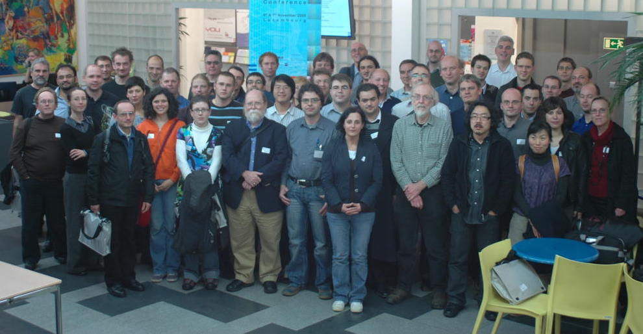
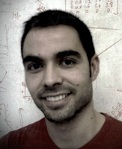
Ignacio Arganda-Carreras: bUnwarpJ
Stephan Saalfeld: landmarks (SIFT, MOPS)
Stephan Preibisch: Stitching
Johannes Schindelin: Fiji!
https://imagej.net/Conference_2008
Notes:
[Curtis] In 2008, CRP Henri Tudor organized a second ImageJ conference. It was becoming a habit to meet.
Lots of stuff was presented here, including Fiji for the first time.

Slide 18
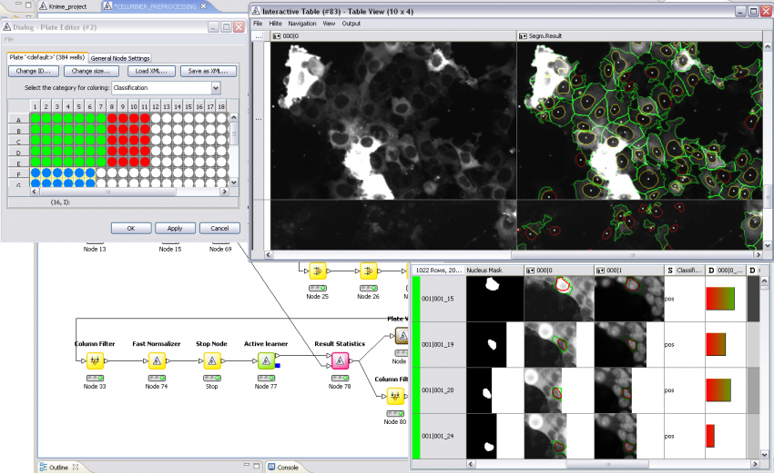
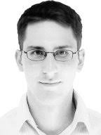
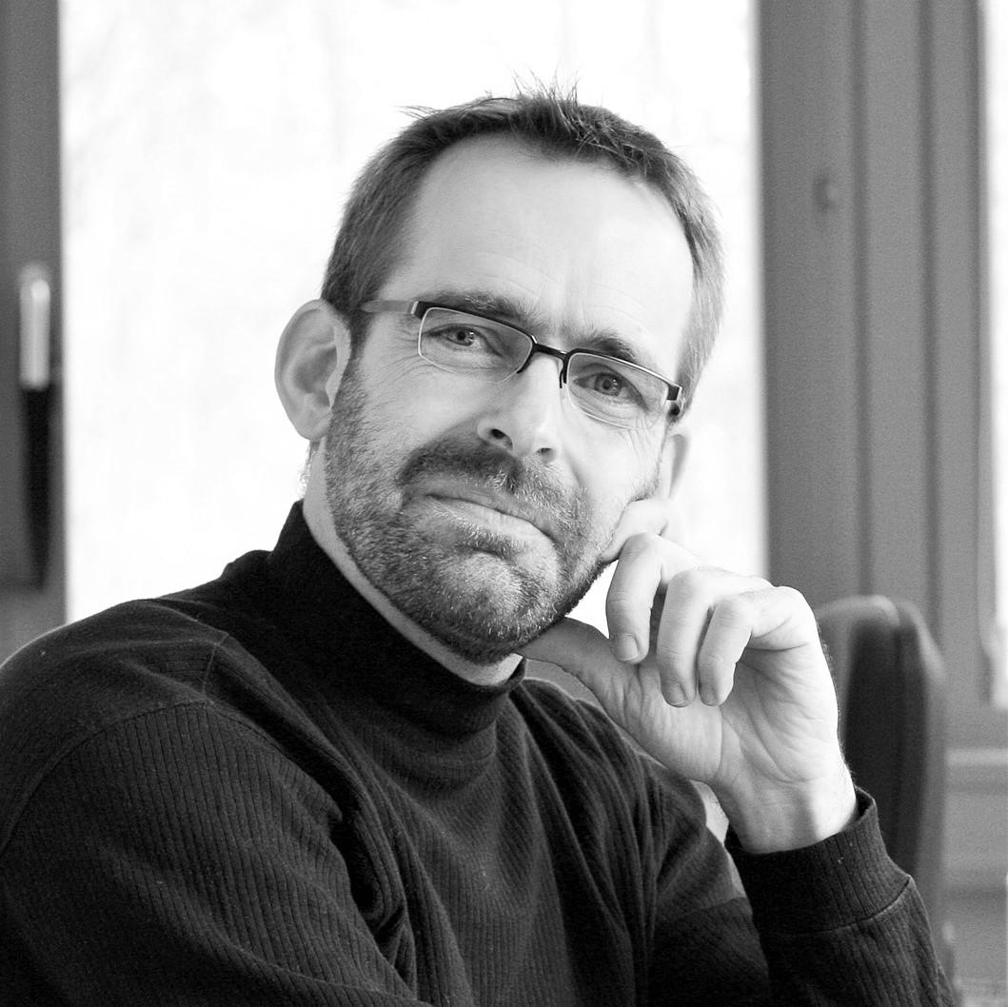
Actually it started in early 2006 with KNIME Image Mining for Active Learning.
https://knime.imagej.net
Notes:
[Christian]

Slide 19
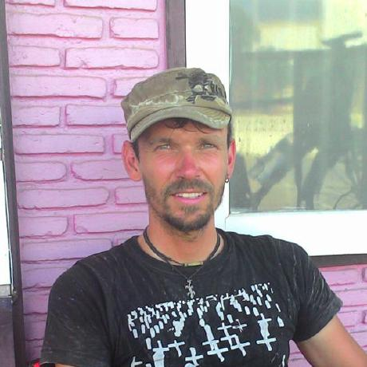
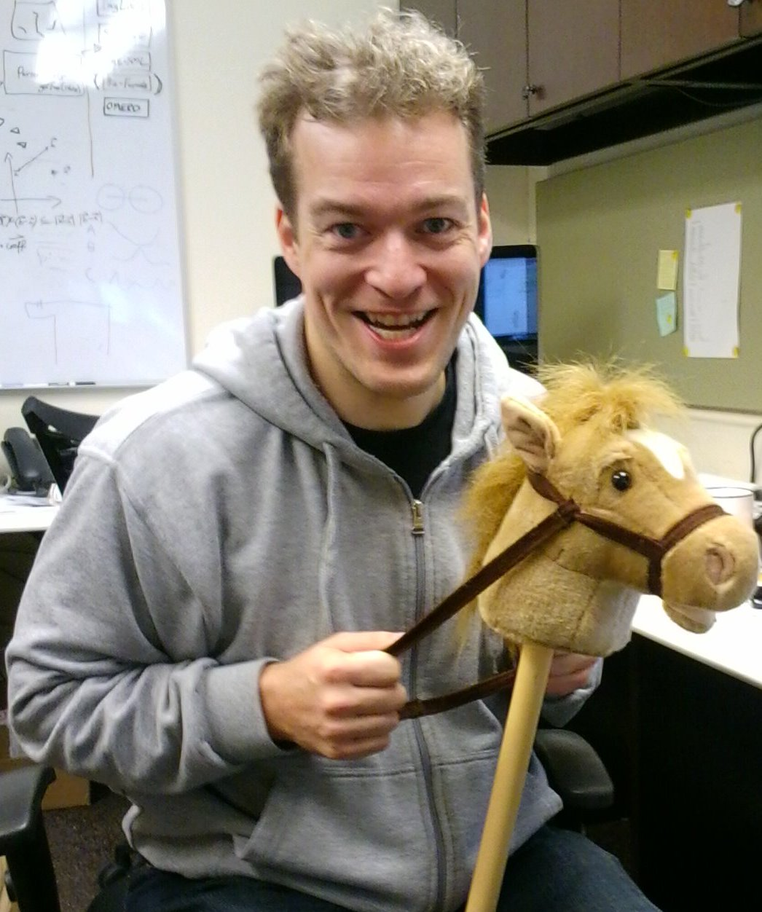
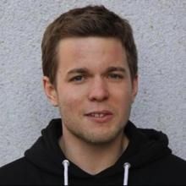
However, those guys met...
https://knime.imagej.net
Notes:
[Christian]
(2009/06)

Slide 20
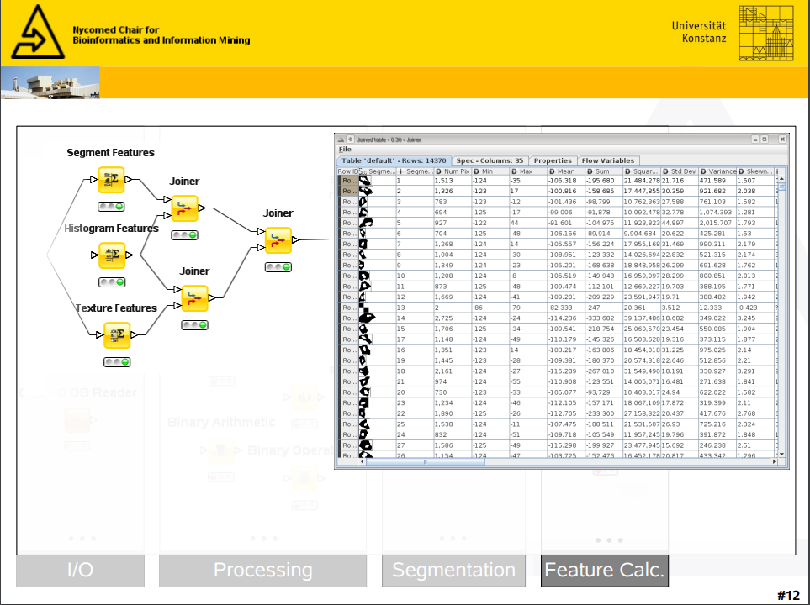
https://knime.imagej.net
Notes:
[Christian]

Slide 21
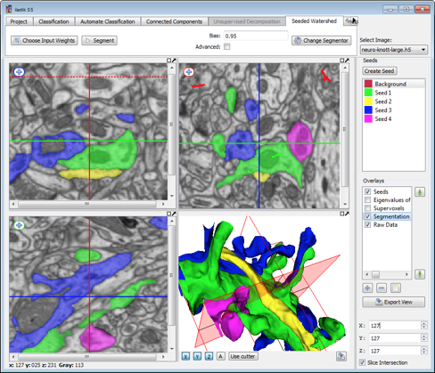
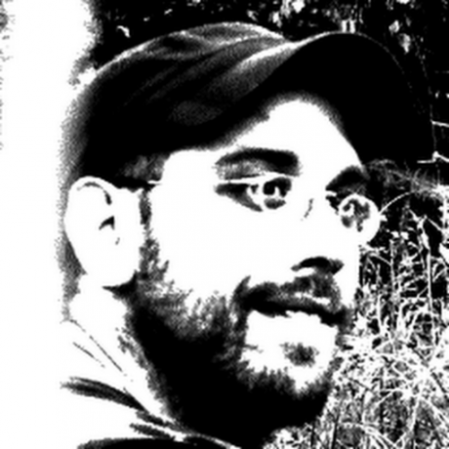
https://www.ilastik.org
Notes:
[Christian]
(2009/07)

Slide 22
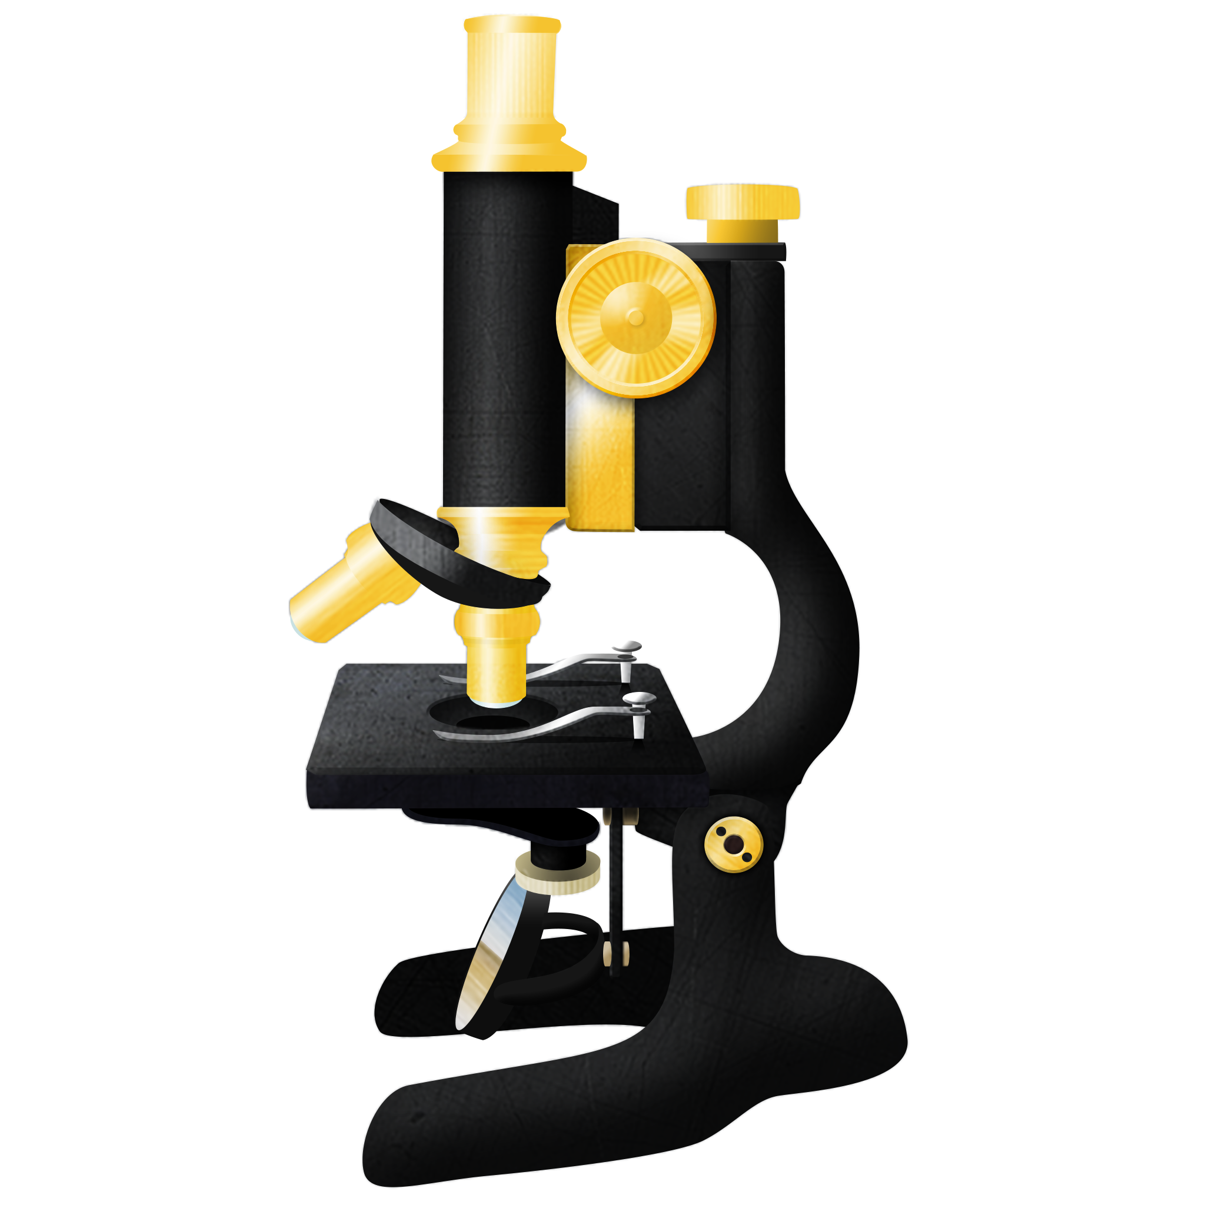
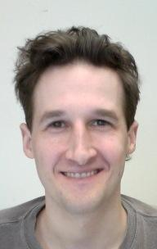
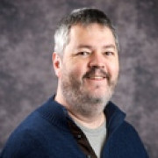
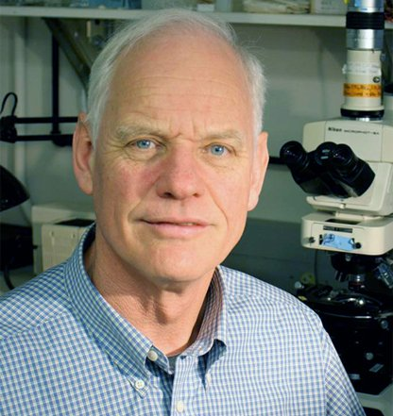
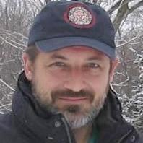
ImageJDev mission statement
Design the next generation of ImageJ, driven by the needs of the community
Collaborate across organizations, fostering open development through sharing and reuse
Broaden ImageJ's usefulness and relevance across many disciplines of the scientific community
Maintain backwards compatibility with existing ImageJ functionality
Unify online resources to a central location for the ImageJ community
Lead ImageJ development with a clear vision
https://imagej.net/ImageJ2
Notes:
[Curtis] In 2009, LOCI partnered with the Broad Institute and the Marine Biological Laboratory at Woods Hole—with letters of support from Wayne Rasband and the Fiji development group—to apply for an NIH “Grand Opportunities” grant to develop a new version of ImageJ with the dubious codename of ImageJDev. We wanted to create something that transcended the limitations of the current ImageJ, while continuing to build on its greatest strengths.
Remember VisBio from earlier? We wanted to bring powerful features like that to ImageJ, as robust and maintainable developments. And we wanted to make ImageJ more reusable from other tools in the bioimage analysis software ecosystem.
To our great surprise, we got funded.

Slide 23
https://imagej.net/ImageJ2
Rueden C. et al. (2017) BMC Bioinformatics
Notes:
[Curtis] Fast forwarding to today, ImageJ2 offers an N-dimensional image engine with extensibility at every level, from image types to dimensionality to user interface. We don’t have time during this talk to cover all of this in much more technical detail, but you can find a wealth of information about ImageJ2 in our 2017 publication in BMC Bioinformatics.

Slide 24
https://imagej.net/2010-03-14_-_Hackathon_at_EMBL
Notes:
[Curtis] It was a lot of work to get to where we are today. In March of 2010, I attended my first Fiji hackathon here at EMBL Heidelberg, organized by Kota Miura, Francesca Peri, and Pavel Tomancak. We discussed many options for how to structure the project technically. We ultimately agreed that the new ImgLib library would be an excellent foundation for a new ImageJ data model. And we started making plans for which parts of Fiji—such as the Fiji Launcher and Fiji Updater—would make sense to generalize as core elements of the ImageJ.
I then spent much of the hackathon trying out different ways to preserve backwards compatibility with ImageJ1, and failing at all of them. But I learned a lot!

Slide 25
Registration of large ssTEM series
Bring computer vision methods to TrakEM2 (SIFT, RANSAC, …)
mpicbg library for global optimization
Elastic deformation
Photometric adjustment
PUT MOVIE
https://imagej.net/TrakEM2
Cardona A. et al. (2012) PLoS One
Saalfeld S. et al. (2012) Nature Methods, Saalfeld S. et al. (2010) Bioinformatics
Notes:
[Tobias] (2010/06)
2010. Meanwhile in Dresden, the Stephans were taking their new library for a spin.
Both were working on image registration problems.
Saalfeld, coming from a computer vision background (i.e., me) tackled registration of large serial section EM data.
He brought methods that were state-of-the-ort then, like RANSAC and SIFT features into TrakEM2.
He started developing the mpicbg library for globally optimizing transformations between point matches.

Slide 26
Registration of multi-view lightsheet data
Fluorescent beads as fiducial markers
Descriptor-based registration
mpicbg library for global optimization
Fusion, Deconvolution, …
Later developed by Stephan Preibisch et al. into BigStitcher
PUT MOVIE
https://imagej.net/SPIM_Registration
Preibisch S. et al. (2010, 2014) Nature Methods
Notes:
[Tobias] (2010/06)
Stephan Preibisch was working on similar problems, but on lightsheet data.
Using fluorescent beads as fiducial markers, Stephan and Stephan came up with a descriptor based registration,
also based on that mpicbg library.
Preibisch added Multi-view fusion and later deconvolution, and kept evolving the tool, which is named BigStitcher in its latest iteration.
There will be a talk about it tomorrow.

Slide 27
Content
https://imagej.net/Conference_2010
Notes:
[Curtis] In 2010, there was a third ImageJ conference. This was the first ImageJ conference I attended, to present our work on ImageJDev.
ImgLib was also presented here! You probably notice that the number of people attending these conferences is growing.

Slide 28
https://imagej.net/2011_Hackathon_in_Madison
Notes:
[Tobias] (2011/01)
In January 2011 I joined Tomancak lab and immediately went to my first hackathon, which was in Madison, Wisconsin.

Slide 29
https://imagej.net/ImgLib2
Notes:
[Tobias] (2011/01)
At this hackathon I became part of the imglib team.
This slide is here because PAvel thinks it is funny. I don’t know what he’s talking about.

Slide 30
ImgLib rewrite
Separation of access to the domain and codomain
Separation of iteration and random access
Separation of real and integer coordinate access
Descriptive names (“RealRandomAccessibleRealInterval”)
Interface-driven, Virtualize Everything
https://imagej.net/ImgLib2
Pietzsch T. et al. (2012) Bioinformatics
Notes:
[Tobias] (2011/01)
At the Madison hackathon, based on work that Saalfeld had started, we changed large parts of imglib design.
ImgLib2 brought better separation of orthogonal concepts
The result was a more elegant and powerful imglib, for example enabling virtually interpolated images, and on-the-fly transformations.
Speaking of elegant, ImgLib2 also brought beautiful descriptive names like “RealRandomAccessibleRealInterval”.

Slide 31
http://icy.bioimageanalysis.org
Notes:
[Curtis] Speaking of elegant! Meanwhile, in France… the Icy bioimaging project announced its first beta, to much acclaim. Finally, bioimaging could be beautiful!

Slide 32
What happened?
https://knime.imagej.net
Notes:
[Christian]

Slide 33
ImageJ(2) / Ops Integration
Trackmate
BigDataViewer Integration
Ilastik Integration
...
https://knime.imagej.net
Notes:
[Christian]

Slide 34
Content
https://scif.io
Notes:
[Curtis] TODO
Say “reading and writing images”

Slide 35
Content
https://imagej.net/2011-12-14_-_Fiji_Hackathon_in_Dresden
Notes:
[Curtis] Finally, in December of 2011, we all came together in Dresden. PAvel invited us all to a big party at MPI-CBG. Fiji, ImageJ2, KNIME, OME and Icy were all in attendance.
At this hackathon, the idea of SciJava was born, thanks to discussions between developers of various different softwares.
[Christian] This is the first time I met everyone face to face.

Slide 36
Nature Methods special focus on Bioimage Informatics
Historical commentary on ImageJ (citation classic)
Perspectives on Fiji, Icy and BioImageXD
Commentaries, bioimage analysis research papers
Dan Evanko
(NM editor)
Schindelin J. et al. (2012) Nature Methods
Notes:
[Tobias]
2012 is a milestone because the whole bioimaging community came together for this Nature Methods special issue.
Several packages had articles in this issue, including Icy, BioImageXD and Fiji.

Slide 37
Interactive visualization of huge image data on a tiny laptop
Resolution pyramids, Blocking, Caching
HDF5 based file format
Extensible backends, annotations
https://imagej.net/BigDataViewer
Pietzsch T. et al. (2015) Bioinformatics
Notes:
[Tobias] (2012/05)
Also in 2012, there was the first BigDataViewer commit.
I wanted to do segmentation on Spim Data and I wanted to interactively look at the results.
My laptop had 3GB of RAM at the time, but I was determined to make it work.
Unfortunately, it got a bit out of hand, and I never got to do those segmentations I wanted to look at.
Much of it was iterations on prototypes by Stephan Saalfeld. For example the iconic wireframe overview in the top-left corner.
Stephan Preibisch integrated BDV in his lightsheet tools, which made the viewer and format really take off.

Slide 38
TODO Curtis? Unsure.
https://imagej.net/Conference_2012
Notes:
[Curtis] The fourth ImageJ conference! And the last one in Luxembourg. It marked the first appearance of KNIME Image Processing at an ImageJ conference.

Slide 39
PUT MOVIE
5 days in 7.5 min intervals → 8 TB
https://imagej.net/MaMuT
Wolff C., Tinevez J.-Y., Pietzsch T. et al. (2018) eLife
Notes:
[Tobias] (2013/03)
1st MaMuT commit
Tassos in PAvels lab, SPIM recording of Parhyale embryogenesis
Wanted to track the data. Simi BioCell couldn’t deal with multiview.
Convergence of two projects.
JYT wanted to adapt TrackMate.

Slide 40
← VisBio + the OME Perl server circa 2006!
https://github.com/imagej/imagej-omero
Notes:
[Curtis] Over the years, LOCI has invested effort in combining ImageJ with OME servers, as seen by the old screenshot here.
In 2013, we began work on the current mechanism for linking ImageJ with an OMERO server. It can upload and download images, regions of interest and tables between OMERO and ImageJ. It you can run ImageJ scripts in the OMERO server side. This library is also what KNIME uses in its OMERO nodes—a nice illustration of our communities joining forces.
In case you are curious: the current ImageJ-OMERO integration is much more awesome than what we had with VisBio plus OME in 2006!

Slide 41
https://imagej.net/ImageJ_Ops
Notes:
[Christian]
A shared library for image processing algorithms, usable from KNIME Image Processing, ImageJ, and others.
Add graphic. Make image smaller?

Slide 42
Fiji split into 130+ components, each released independently
“Eat our own dog food” – community plugins can be structured the same way
https://github.com/fiji
Notes:
[Curtis] In late 2014, the code of Fiji had grown quite large. So we split it into pieces, to make it easier to manage and extend.

Slide 43
https://github.com/fiji/TrackMate3
Notes:
[Tobias] (2014/05)
1st Mastodon commit
MaMuT didn’t deal well with millions of annotation created by automatic tracking
→ rewrite of trackmate core
Represent tracking graphs by: Proxy objects on primitive arrays, interfaces, …, similar ideas as imglib2.

Slide 44
https://github.com/fiji/TrackMate3
Notes:
[Tobias] (2014/05)
Things don’t always go as planned…
Mid 2017 seemed ridiculously far in the future.
(Curtis: I also remember seeing this in 2015, and thinking: “mid 2017? Ha, how ridiculously far in the future.”)

Slide 45
Fiji Is Just ImageJ2!
2.0.0 release of ImgLib2 to Maven Central
Reproducible builds – all components built on release versions
https://imagej.net/2015-02-04_-_ImageJ_in_2014_and_2015
Notes:
[Curtis] For the next year, we worked hard on stabilizing ImageJ2. In late 2014, we completed the transition to making Fiji fully built on ImageJ2. After this point, when you launch Fiji, it is launching ImageJ2, with a backwards compatibility layer for the ImageJ1 functionality.
Shortly after we completed this work, Johannes Schindelin, who had been working in Madison since fall of 2011, returned to MPI-CBG.
For those of you who love the “Compile and Run” command: this is probably when it stopped working. ;-)

Slide 46
Konstanz Hackathons
ImageJ-Ops
KNIME CellProfiler Integration
ClearVolume
Labelings
...
Notes:
[Christian]
Florian Jug’s first hackathon.
And great swag.

Slide 47
...
Notes:
[Christian]

Slide 48
TODO-replace title with 2015 SCIFIO Janelia hackathon
Melting Pot
https://imagej.net/2015-07-27_-_Janelia_Hackathon
Notes:
[Curtis] CTR TODO - And then there was yet another mini-hackathon at Janelia in July, to work on SCIFIO.
Stephan forced Curtis to write the “melting-pot” script and it has been very effective at catching issues.

Slide 49
Content
https://imagej.net/BoneJ2
Notes:
[Curtis] TODO
This is the first time that a domain got direct funding.

Slide 50
Conference hosted at UW-Madison
With Learnathon + Hackathon!
Deconvolution in ImageJ Ops
ImageJ-ITK integration
https://imagej.net/Conference_2015
Notes:
[Curtis] The fifth ImageJ conference in 2015 was organized and hosted in Madison, Wisconsin by LOCI. There was a “Learnathon” afterward, to show developers the new ImageJ and SciJava APIs, and a hackathon with exciting new developments. The ImageJ Discourse forum, which later morphed into the Image.sc Forum, was launched at this time, too.

Slide 51
version = 1.5 Exception in thread “J3D-Renderer-1” java.lang.UnsatisfiedLinkError: /Applications/Fiji.app/java/macosx-java3d/Home/lib/ext/libjogl_awt.jnilib: Library not loaded: /System/Library/Frameworks/JavaVM.framework/Libraries/libjawt.dylib Referenced from: /Applications/Fiji.app/java/macosx-java3d/Home/lib/ext/libjogl_awt.jnilib Reason: image not found at java.lang.ClassLoader$NativeLibrary.load(Native Method) at java.lang.ClassLoader.loadLibrary0(ClassLoader.java:1833) at java.lang.ClassLoader.loadLibrary(ClassLoader.java:1722) at java.lang.Runtime.loadLibrary0(Runtime.java:823) at java.lang.System.loadLibrary(System.java:1044) at com.sun.opengl.impl.NativeLibLoader.loadLibraryInternal(NativeLibLoader.java:189) at com.sun.opengl.impl.NativeLibLoader.access$000(NativeLibLoader.java:49) at com.sun.opengl.impl.NativeLibLoader$DefaultAction.loadLibrary(NativeLibLoader.java:80) at com.sun.opengl.impl.NativeLibLoader.loadLibrary(NativeLibLoader.java:103) at com.sun.opengl.impl.NativeLibLoader.access$200(NativeLibLoader.java:49) at com.sun.opengl.impl.NativeLibLoader$2.run(NativeLibLoader.java:132) at java.security.AccessController.doPrivileged(Native Method) at com.sun.opengl.impl.NativeLibLoader.loadAWTImpl(NativeLibLoader.java:118) at com.sun.opengl.impl.JAWT.getJAWT(JAWT.java:91) at com.sun.opengl.impl.macosx.MacOSXOnscreenGLDrawable.lockSurface(MacOSXOnscreenGLDrawable.java:144) at com.sun.opengl.impl.macosx.MacOSXOnscreenGLContext.makeCurrentImpl(MacOSXOnscreenGLContext.java:57) at com.sun.opengl.impl.GLContextImpl.makeCurrent(GLContextImpl.java:134) at javax.media.j3d.JoglPipeline$QueryCanvas.doQuery(JoglPipeline.java:9049) at javax.media.j3d.JoglPipeline.getBestConfiguration(JoglPipeline.java:8797) at javax.media.j3d.Renderer.doWork(Renderer.java:514) at javax.media.j3d.J3dThread.run(J3dThread.java:275)
https://imagej.net/2015-12-22_-_The_road_to_Java_8
Notes:
[Curtis] TODO

Slide 52
Network of bioimage analysts within Europe
Strengthen the bridge between life sciences and computer science
Establish Bioimage Analyst as career path to support experimental scientist
Offer trainings that use established tools for construction of bioimage analysis workflows
and ~200+ more
https://neubias.org/
Notes:
[Christian] (2016/04)
In 2016, NEUBIAS was funded. NEUBIAS means “Network of Bioimage Analysts in Europe.” NEUBIAS now allows us to train a lot of people in bioimage analysis tools.
If you want to learn more about that, listen to the talk of Julien tomorrow at 5pm.

Slide 53
https://imagej.net/2016-06-23_-_ImgLib2_hackathon
Notes:
[Christian]
Christian “Space Tree” Dietz, Tobi “Meta” Pietzsch, …
Going crazy from too many hackathons

Slide 54
RESTful image server backed by ImageJ
Discover and execute ImageJ modules remotely
Talk to ImageJ from any programming language
Talk to ImageJ from other machines
DELETE /admin/stop GET /modules GET /modules/{id} POST /modules/{id} GET /objects POST /objects/upload DELETE /objects/{id} GET /objects/{id} GET /objects/{id}/{format}
https://imagej.net/ImageJ_Server
Notes:
[Curtis] In 2016, Leon Yang and Curtis Rueden of LOCI developed the ImageJ Server as a potential solution for integrating CellProfiler and ImageJ. The previous integration mechanism, developed as part of the ImageJDev funding, was difficult to maintain, so the CellProfiler team dropped ImageJ support with the 3.0 release.
The ImageJ Server is not a tool for end users. It is way for other programs to integrate with ImageJ. Programmers can write code to communicate with ImageJ in a broad array of situations.

Slide 55
Funding keeps coming! Grant from the Czech ministry of education
Support for 4 developers for 4 years at IT4I in Ostrava Czech Republic
Parallelization of Fiji on a cluster
January 16-29th 2019 Ostrava hackathon
https://events.it4i.cz/indico/event/18/
Notes:
[Curtis] For example, the IT4Innovations national supercomputing center in the Czech Republic is using the ImageJ Server to drive parallelization of Fiji on a cluster, with the goal of executing ImageJ macros and scripts easily on a cluster computing infrastructure. This is another recently funded effort from the Czech ministry of education, supporting 4 developers for 4 years. There is an upcoming Fiji hackathon in Ostrava this January focusing on this goal of parallelization.

Slide 56
Dresden Analysis of Images Suite
Represents the first funding dedicated to support Fiji
Fiji becomes part of de.NBI German Bioinformatics network
Provide and maintain stable software stack for image analysis
Training events: hackathons and learnathons
https://imagej.net/DAIS
Notes:
[Tobias] (2016/12)
Another recently funded effort is the DAIS.
With support from KNIME, Fiji became part of de.NBI, the German Network for Bioinformatics Infrastructure.
Being an infrastructure project, de.NBI is focused on support, documentation, community-building, and education.

Slide 57
Hackathons
2016, 2017
Learnathons
2017, 2018
Notes:
[Tobias]
The DAIS funding allowed us to establish annual Hackathons, usually taking place in Dresden in December.
In the summer, we established annual Learnathons.
During the learnathons we try to attract new developers to our ecosystem, teaching them about ImgLib2, ImageJ2, KNIME, and so on.

Slide 58
Generalize BigDataViewer cached images
Writable cached images
https://github.com/imglib/imglib2-cache
Notes:
[Tobias] (2017/01-03)
In early 2017, I was a visitor in Saalfeld lab in Janelia for 3 months.
The first project I took on was generalizing the BDV caches and integrating them into imglib2.
Part of this was making cached images writable, which was not possible in BDV.
This project was supposed to take 2 weeks or so, but ended up occupying full 3 months.
This has become a super-important part of imglib2.
Today every algorithm based on imglib2 can operate on terabyte-sized images as if they would fit in your memory.
As a silly example, here you can see me interactively painting into a virtual 4PB image.

Slide 59
Geometric, parametrized ROI shapes
Combine in tree hierarchy with:
Boolean operations
Transformations
https://imagej.net/Hackathon
Notes:
[Tobias]

Slide 60
https://imagej.github.io/tutorials https://imagej.net/Jupyter
Notes:
[Curtis] Hadrien Mary, a postdoc at McGill University, was interested in making ImageJ more accessible from Jupyter Notebook, a powerful environment for interactive computing commonly used with PyData libraries (NumPy, ScyPy, scikit-image, etc.). Java historically did not work in Jupyter Notebook, but fortunately a new project called BeakerX had now made it possible. Soon we had working BeakerX-based notebooks that ran ImageJ in the background, offering full access to the power of the ImageJ2 API. The only problem was that because the notebooks were Java-based rather than Python-based, these notebooks could not make use of PyData libraries.

Slide 61
Shared image memory: numpy + ImgLib2
https://github.com/imglib/imglyb
Notes:
[Curtis] Meanwhile, at Janelia Research Campus, Philipp Hanslovsky of Stephan Saalfeld’s group also wanted to bring the Java and Python worlds closer together. He created a bridge between ImgLib2 and NumPy that wrapped NumPy images in-place using shared memory. With ImgLyb, you can work in Python with the PyData stack, wrap the images to Java without copying pixels, then process the images using ImgLib2-based algorithms.

Slide 62
https://pypi.org/project/pyimagej
Notes:
[Curtis] By the end of 2018, Philipp and I had developed a stack of Python libraries built on these ideas allowing Python to download ImageJ or Fiji on demand, wrap all the Java functionality into Python, and freely mix and match PyData- and ImageJ-based algorithms. If you want to learn more, visit the URL shown here, or come to my Jupyter Notebook workshop tomorrow.

Slide 63
https://imagej.net/TensorFlow
https://imagej.net/Microscope_Focus_Quality
Yang S. et al. (2018) BMC BioInformatics
Notes:
[Curtis] Another relatively new development from 2017 is ImageJ-TensorFlow, a library for executing trained TensorFlow models in ImageJ. The project that drove the development of this library was a partnership with the Google Accelerated Science team, who had recently developed a method for training TensorFlow models that could classify microscope image focus quality. They wanted to make this mechanism accessible from both ImageJ and CellProfiler. Soon, ImageJ-TensorFlow was in use at MPI-CBG as well...

Slide 64
http://csbdeep.bioimagecomputing.com/
Notes:
[Tobias]

Slide 65
https://imagej.net/Hackathon
Notes:
In April this year, Kyle Harrington organized a hackathon in Moscow ...

Slide 66
https://imagej.net/Hackathon
Notes:
… Idaho

Slide 67
3D viewer replacement
Volumes + Meshes + ...
https://imagej.net/SciView
https://github.com/scenerygraphics
Notes:
The topic of the hackathon was 3D visualization.
SciView, Kyle’s project is intented as a replacement for the ImageJ 3D Viewer.
SciView is based on scenery, by Ulrik Günther, which is a new 3D rendering library
It has Vulkan & OpenGL backenda.
It supports the major platforms, and it supports virtual reality headsets and so on.

Slide 68
“BigVolumeViewer”
Volume rendering of BigDataViewer datasets.
Incomplete / experimental.
Backend-neutral library.
Is / will be used in scenery / SciView.
https://github.com/tpietzsch/jogl-minimal
http://sites.imagej.net/BigVolumeViewer
Notes:
I started developing BigVolumeViewer at this hackathon,
which is about volume rendering BigDataViewer dataset,
that is datasets that do not fit in your GPU memory.
Here you see it integrated in the Mastodon tracking tool, which I will talk about tomorrow.
Thanks to Ulrik, it has been integrated into scenery, more or less today.
And it should be integrated into SciView soon.

Slide 69
Content
https://github.com/imagej/imagej-node https://github.com/imaging-tools
Notes:
[Curtis] In May I attended a hackathon at the Chan Zuckerberg Biohub in San Francisco. There are a whole class of software tools targeting the web, such as several cell atlas projects. We started exploring how the communicate could bridge the gulf between web development technologies and more traditional desktop-oriented approaches.

Slide 70
FINALLY! Funding for Fiji development
Fiji succeeds in highly competitive Software Sustainability call by DFG
Two developers/maintainers funded for 3 years without need to do science
The future is bright
Notes:
[Tobias] (2018/06)
2018 is also the year where we finally got funding for Fiji development.
Fiji succeeded in the Software Sustainability call by DFG, which gave us funding for two developers/maintainers.
We will finally be able to help Curtis with the insane maintenance and devops workload.
So it definitely looks like things are moving.

Slide 71
https://forum.image.sc/
Notes:
[Curtis] At the some point in 2017, the idea arose to generalize the ImageJ Forum beyond only ImageJ, so that it could serve as a hub for the bioimage analysis community and beyond. LOCI partnered with the Broad Institute once again, to combine the CellProfiler and ImageJ forums into a single entity dubbed the Image.sc Forum. There were some technical delays in achieving a clean merge, but with the help of Civilized Discourse Construction Kit, Inc., the company behind the Discourse forum software, the project finally launched in August of this year.
The result of this effort is that today, we have one joint place where ...

Slide 72
Notes:
[Tobias]
2018/09/27 Fiji paper reaches 10k citations

Slide 73
https://www.embl.de/training/events/2018/IMJ18-01/
Notes:
[Florian]

Slide 74
Putting it all together...
ImgLib2 for everything
SCIFIO / N5 for IO
BDV, LabKit, SciView
Ops for algorithm
New: CompGraphs to model workflows
https://knime.imagej.net
Notes:
[Christian]

Slide 75
2099 …
Notes:
[Curtis] TODO

Slide 76
ImageJ and Friends
people
software

